Slide 1

Income Prediction Model
IronHack
Data Analytics
Presented by: Jomana Bakhiet

Slide 2

Agenda
Introduction
Dataset
Hypothesis Testing
Regression Model
Conclusion

Slide 3

Introduction
Dataset: Adult income dataset
Questions:
Which Educational level has a greater proportion of adults with income more than $50,000 per year?
Is there a relationship between level of education & income?
What is the effect of each feature on the likelihood of earning more than $50,000 per year?

Slide 4

Adult income dataset
Let’s explore it

Slide 5
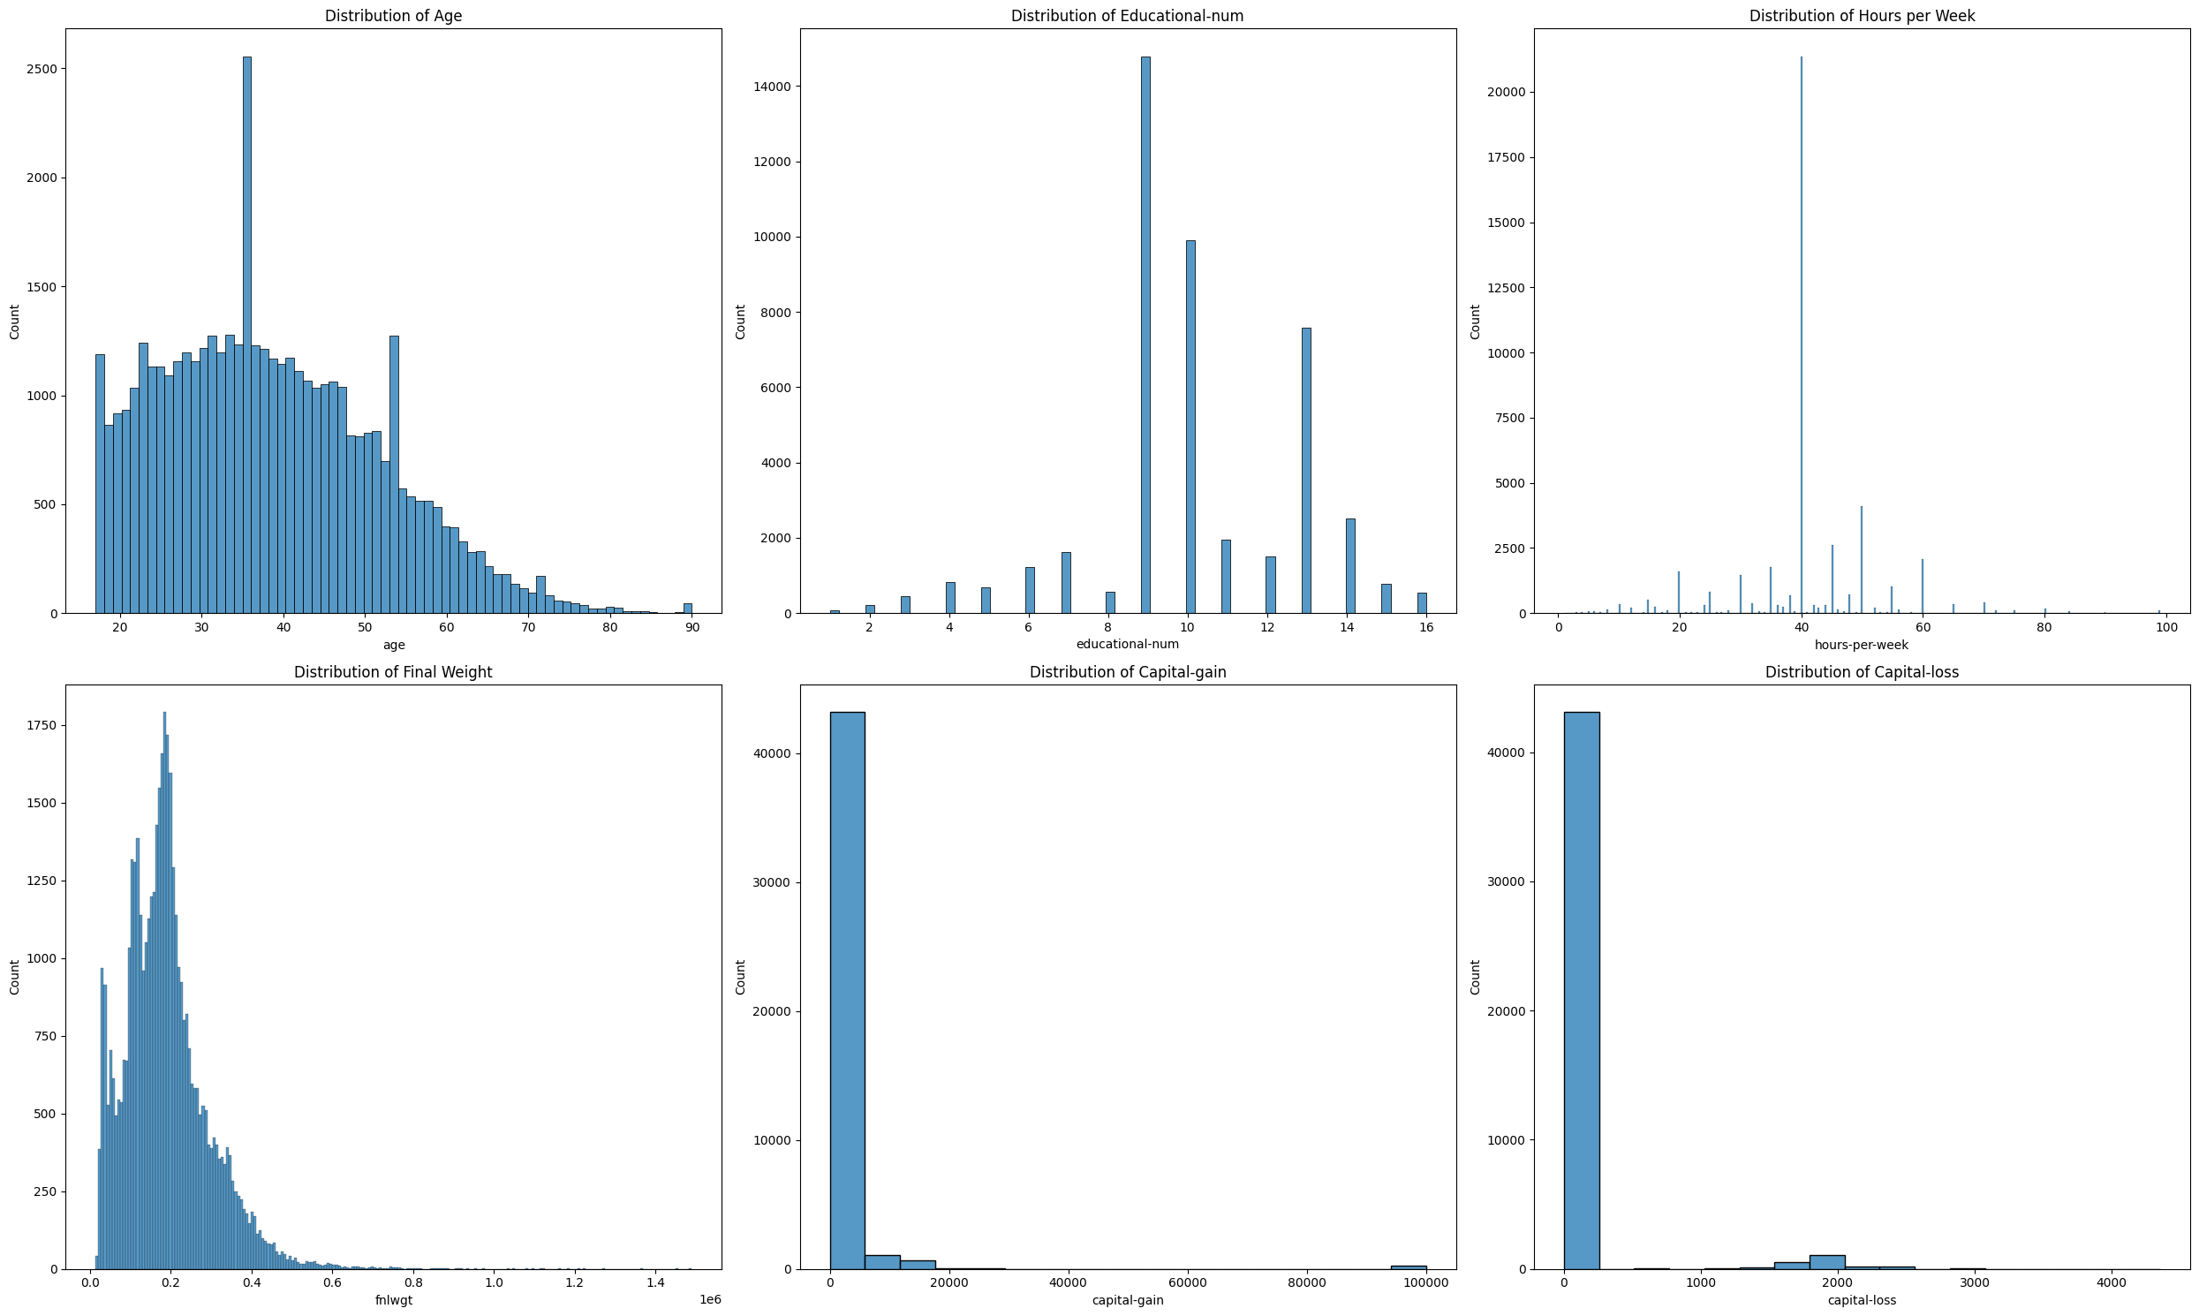
Numerical Variables

Slide 6
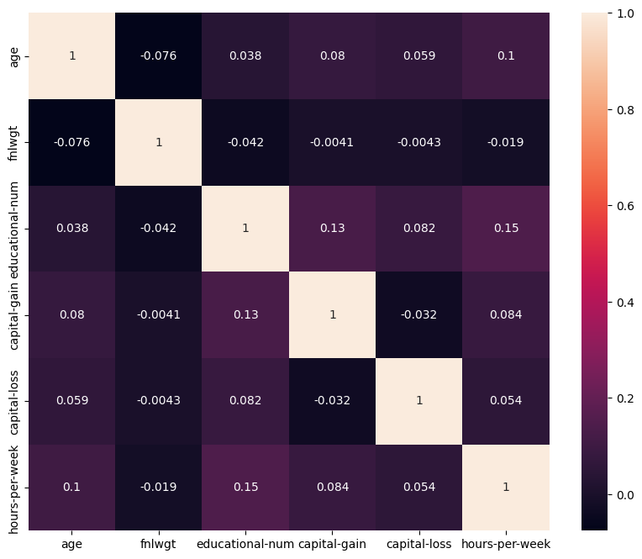
Numerical Variables

Slide 7

Which Educational level has a greater proportion of adults with income more than $50,000 per year?
Let’s figure this out

Slide 8
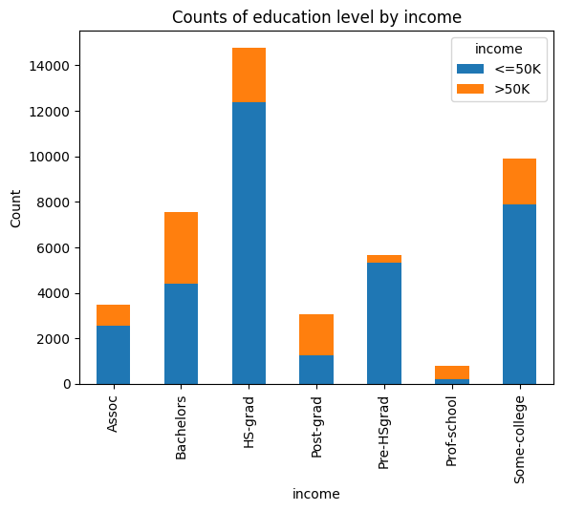
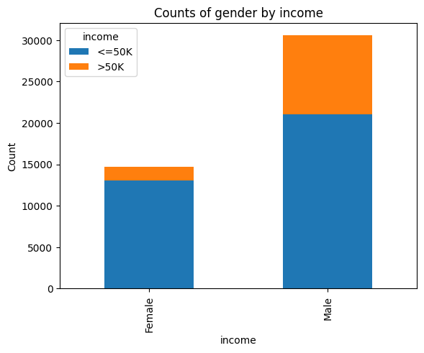
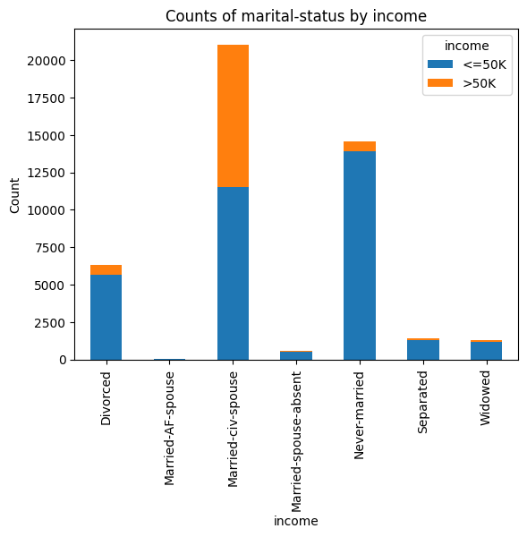
Categorical Variables

Slide 9
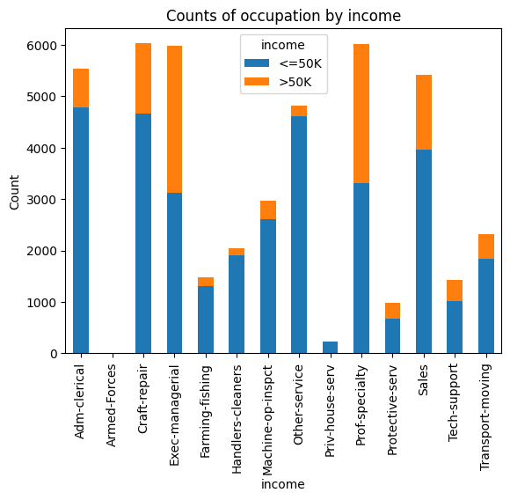
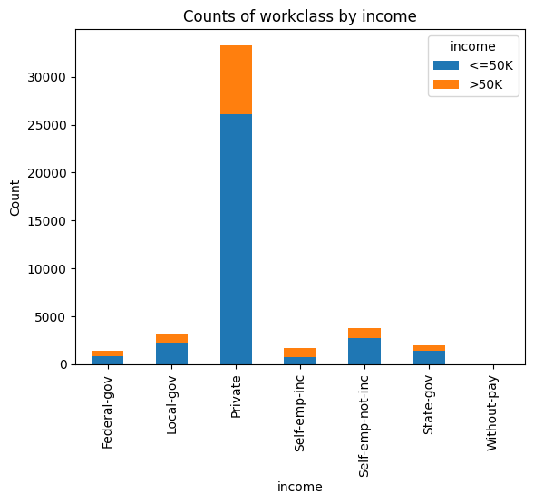
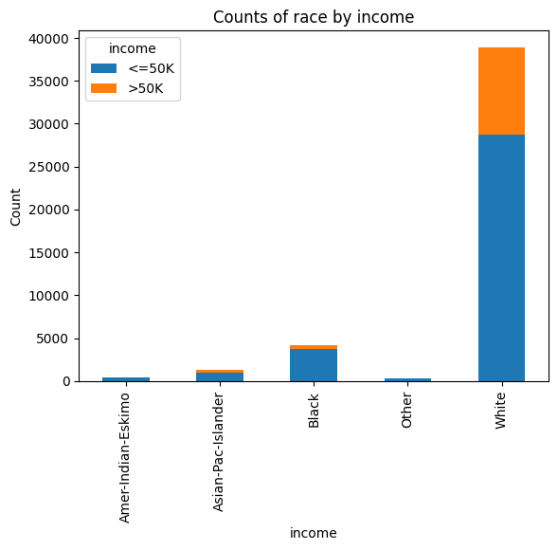
Categorical Variables

Slide 10
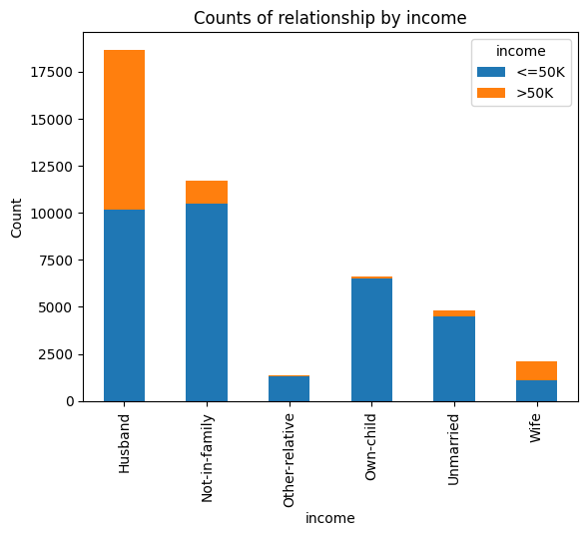
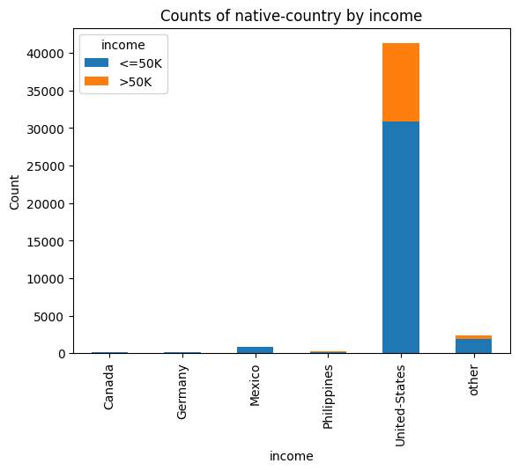
Categorical Variables

Slide 11
Is there a relationship between level of education & income?
Let’s figure this out

Slide 12
Hypothesis Testing
Hypothesis H0: There is no relationship between education level and income level.
H1: There is a relationship between education level and income level.
Statistical Test
chi-squared test
Significance Level
Alpha is 0.05
pvalue
Pvalue = 0
Pvalue < 0.05
Reject the null-hypothesis
There is relationship between level of education and income.

Slide 13
What is the effect of each feature on the likelihood of earning more than $50,000 per year?
Let’s build our model
Notes:
A logit regression model is applied to answer this question

Slide 14
Numerical Variables Transformed

Slide 15
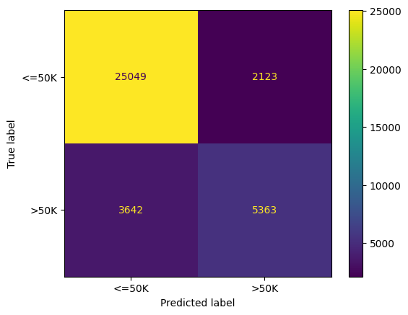
Logistic Regression
TRAIN SET
The accuracy in the TRAIN set is: 0.84
The precession in the TRAIN set is: 0.87
The recall in the TRAIN set is: 0.92
The F1-score for the TRAIN set is 0.90
The Kappa in the TRAIN set is: 0.55

Slide 16
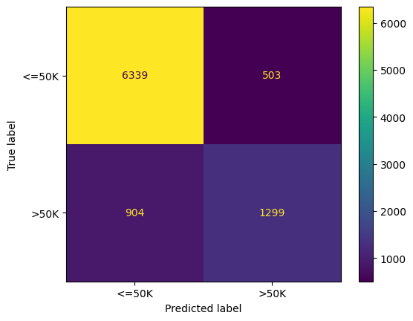
Logistic Regression
TEST SET
The accuracy in the TEST set is: 0.84
The precession in the TEST set is: 0.88
The recall in the TEST set is: 0.93
The F1-score for the TEST set is 0.90
The Kappa in the TEST set is: 0.55

Slide 17
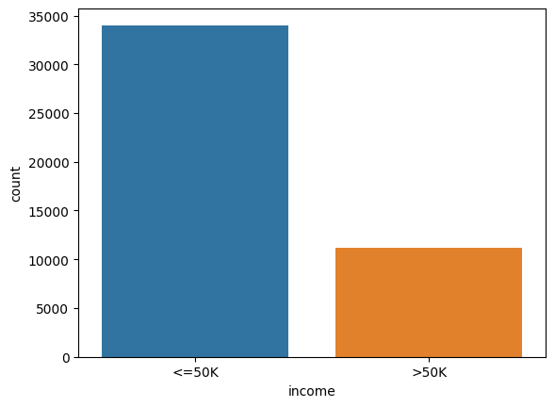
Logistic Regression
DATA IMBALANCE
The class imbalance ratio is: 0.50

Slide 18
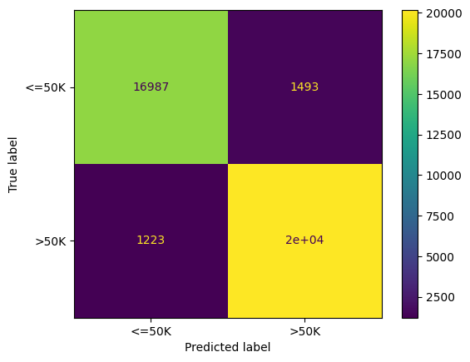
Logistic Regression
TRAIN SET
The accuracy in the TRAIN set is: 0.93
The precession in the TRAIN set is: 0.93
The recall in the TRAIN set is: 0.92
The F1-score for the TRAIN set is 0.93
The Kappa in the TRAIN set is: 0.86

Slide 19
Logistic Regression
TEST SET
The accuracy in the TEST set is: 0.84
The precession in the TEST set is: 0.88
The recall in the TEST set is: 0.93
The F1-score for the TEST set is 0.90
The Kappa in the TEST set is: 0.55

Slide 20
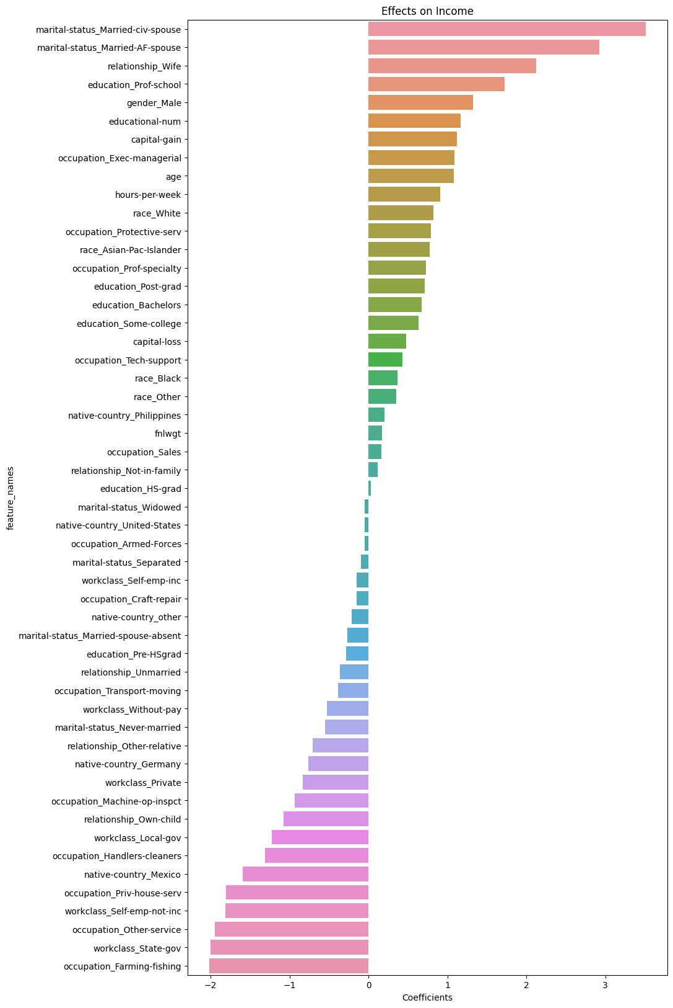

Slide 21

Conclusion
The analysis shows that there is a relationship between level of education & income;
Adults with Bachelor degree have a more on income >50 compared to other Educational levels;
The model's performance was hindered by a critical issue in the data, which made it incompatible with the classifier's functioning.
Notes:
I think because the data is not easily linearly separable, the classifier fails to predict the variables, if the income was the actual salaries of the data set individuals, the model would have performed better.
Also, I have been very cautious on removing variables because I don’t want to compromise the data as I may end up removing valid information. As a result, I may have kept variables that I should have removed.
The data imbalance

